Slide 1
Mange in dogs and cats
Prof: KAMAL M. ALSAAD

Slide 2
Mange is caused by tiny external parasites called mites which can lead to severe irritation of the skin which can significantly impact the pets quality of life.
Types of mange
There are three types of mites responsible for mange in pets
Sarcoptes mites cause sarcoptic mange
Demodex mites cause demodectic mange
Ear mites (Otodectes cynotis) cause otodectic mange

Slide 3
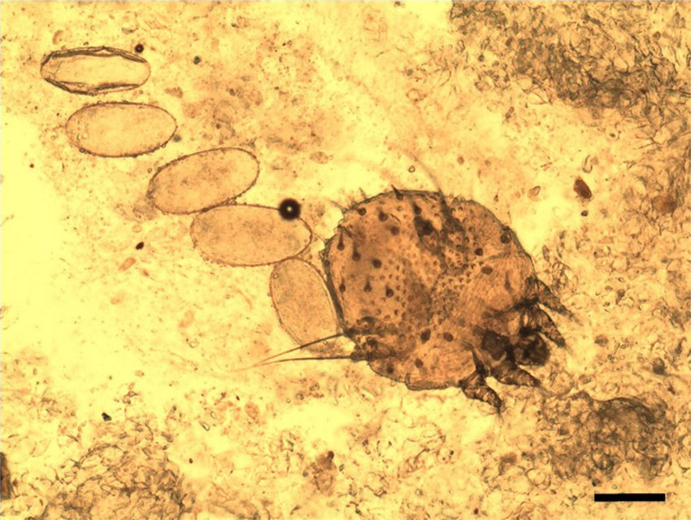
Sarcoptic mange
Sarcoptic mange (also known as scabie) is a highly contagious skin condition caused by microscopic Sarcoptes mites. Sarcoptic mange is an extremely itchy skin disease. The pet variety of the mite can also infest humans and cause temporary dermatitis with intensely itchy skin lesions that can last for several weeks.

Slide 4
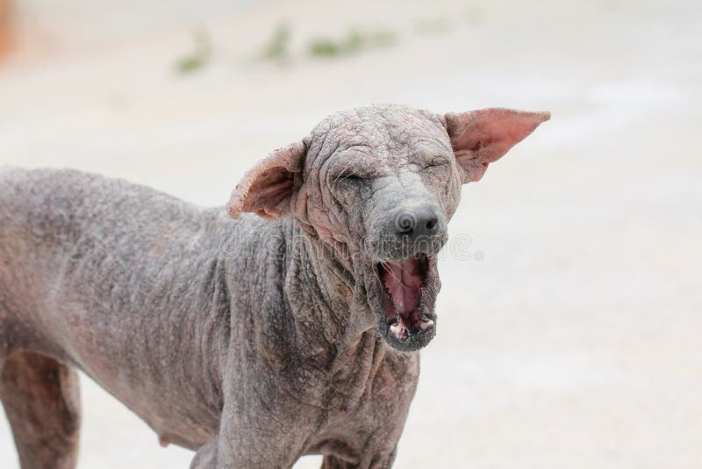

Slide 5
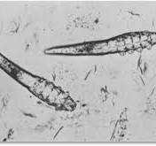
Demodectic mange
Demodectic mange is caused by microscopic Demodex mites that live in the pets hair follicles. Demodex mites are a normal inhabitant of a dog’s skin, however, they can cause skin disease if the immune system cannot control the mite population

Slide 6
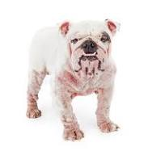

Slide 7
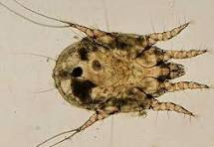
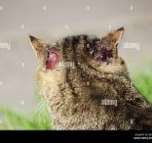
Otodectic mange
Otodectic mange is a common condition, caused by ear mites (Otodectes cynotis). Ear mites can cause intense ear irritation and discomfort. These tiny parasites feed on wax and oils in ear canals. They can result in head shaking or scratching, rubbing of the ears and secondary ear infections.

Slide 8
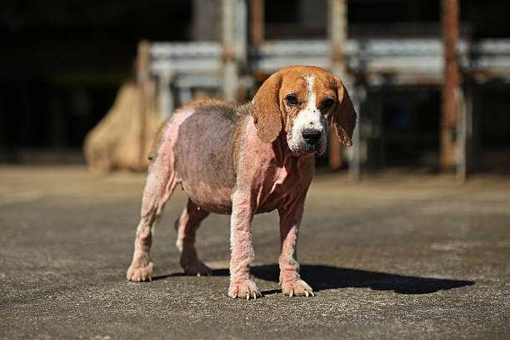

Slide 9
Symptoms of Mange
Clinical signs of mange include:
Severe itching
Biting the skin (less common in demodectic mange)
Alopecia (hair loss) with Redness of the skin
Excoriations (self-inflicted superficial or deep wounds)
Raised bumps (papules) most commonly on the chest.
Thick crusted skin typically found on the margins of the ears, the ankles (hocks), armpits, and elbows .and scabs
Often, secondary skin infections occur because of the skin lesions. Weight loss, depression, decreased appetite, and lethargy can be caused by the severe itching and uncomfortable skin issues. Enlarged lymph nodes may be found too.
A subtype of scabies called Norwegian scabies is characterized by severe skin crusting and is thought to be worsened by a compromised immune system

Slide 10
Treatment ……
1- Amitraz (Triazapentadiene )
Amitraz is a topical treatment primarily used to treat pet ectoparasites , Amitraz for demodicosis is applied topically as a bath or dip pouring or spray.
The recommended concentration varies from 0.025% to 0.06% once weekly to every two weeks.
Clinical signs of toxicosis include hypotension, hypothermia, bradycardia, convulsions, mydriasis, CNS and respiratory depression, lethargy, ataxia, hypersalivation, anorexia, vomiting, hyperglycemia, and gastrointestinal disorders in animals.
Atipamezole or yohimbine is a specific antidote with symptomatic treatment

Slide 12
2- Ivermectin by S.C injection of 0.2- 0.4 mg/kg
3- Milbemycin oxime at a dose of 0.5–2 mg/kg daily orally
4- Moxidectin at dose rate of at 300–400 µg/kg orally
5- Doramectin 600μg/kg/week subcutaneous injection
6-Hemopathic treatment which include the use of Sulphur, and Silicea
Progression & Possible Complications
The main complication from sarcoptic mange is secondary skin infections; dogs and cats with sarcoptic mange will sometimes be prescribed antibiotics to treat or prevent them. A very small percentage of animals can develop more severe infections that require more treatment, but this is uncommon.

